Slide 1
ENSE 470 - Milestone 7
Group Name: GLHF
Group Members:
Vincent Chan
Thiago De Melo
Shuaihao Zhao
Joe Emmanuel Samano
April 12, 2018
Notes:
Joe

Slide 2
Introduction
Team Commit

Slide 3
Screenshots of Completed Product

Slide 4
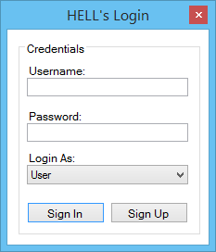

Slide 5
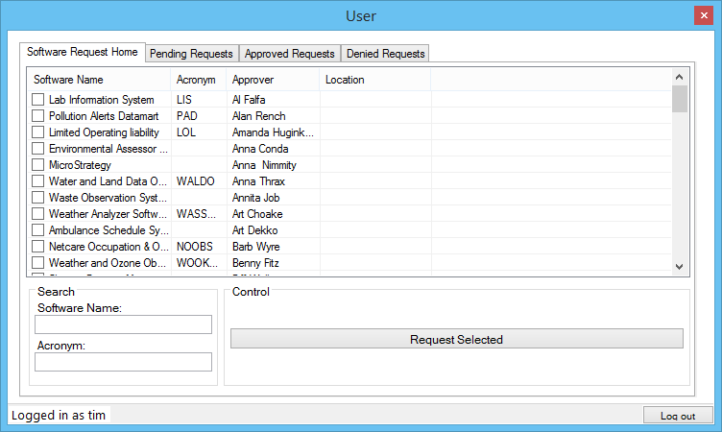

Slide 6
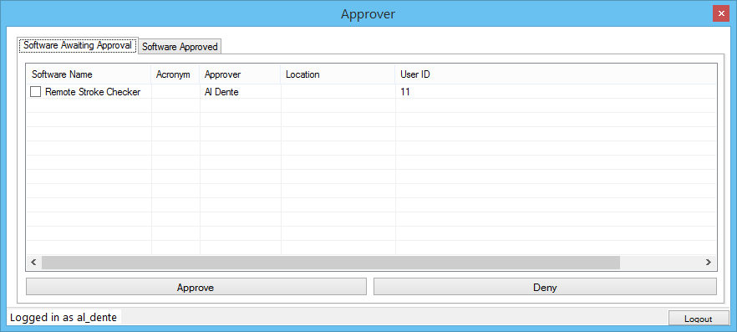

Slide 7
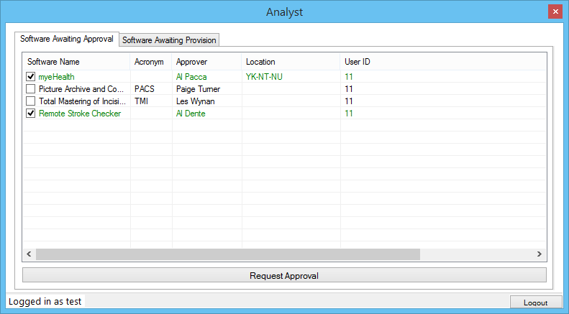

Slide 8
GitHub Review

Slide 9
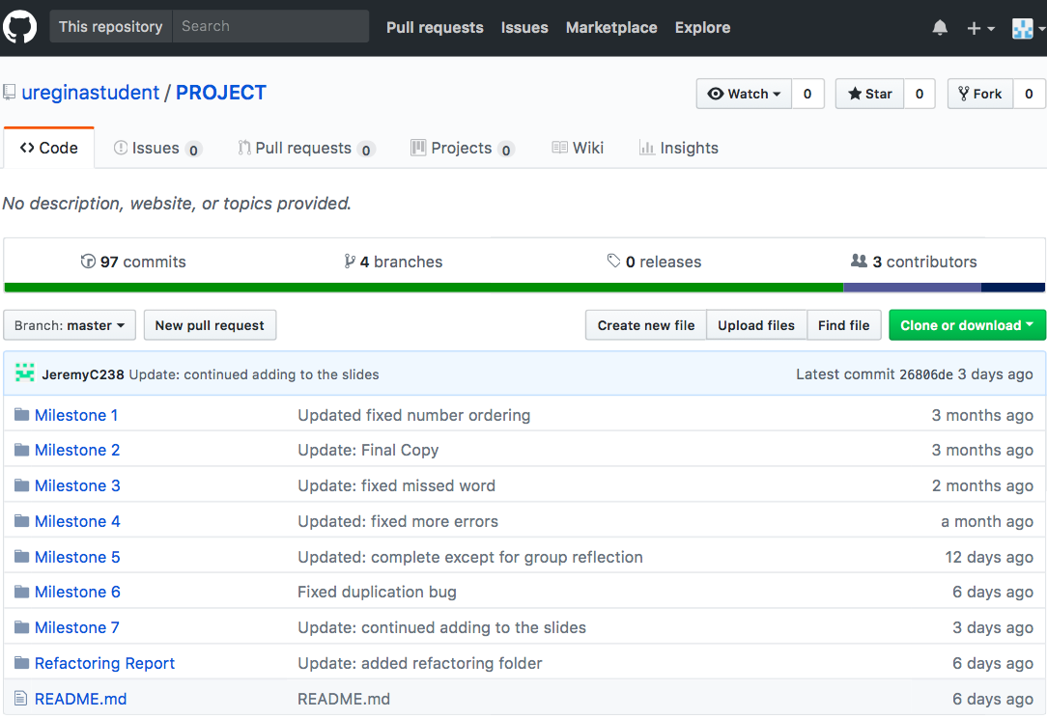
Clean, Readable
Organize
Easy to navigate

Slide 10
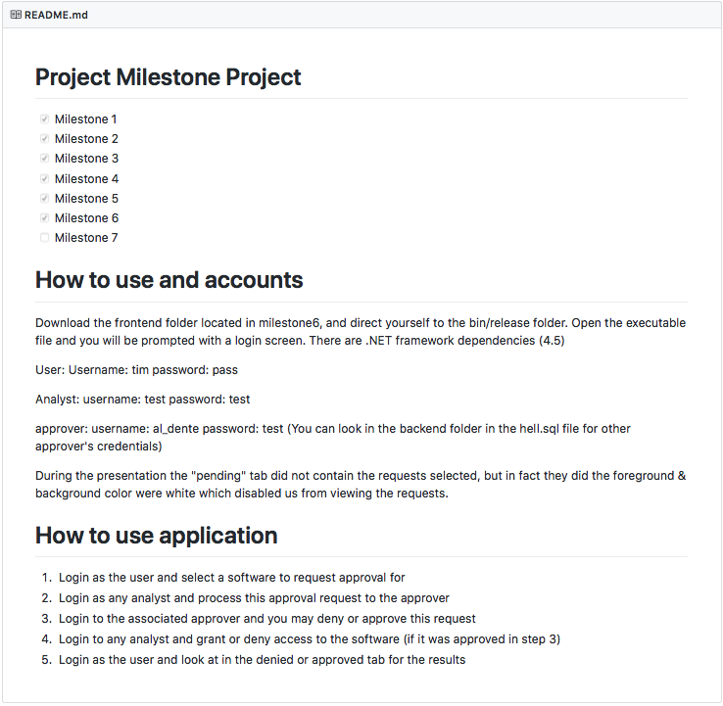
Great
Convenient
Easy to Understand

Slide 11
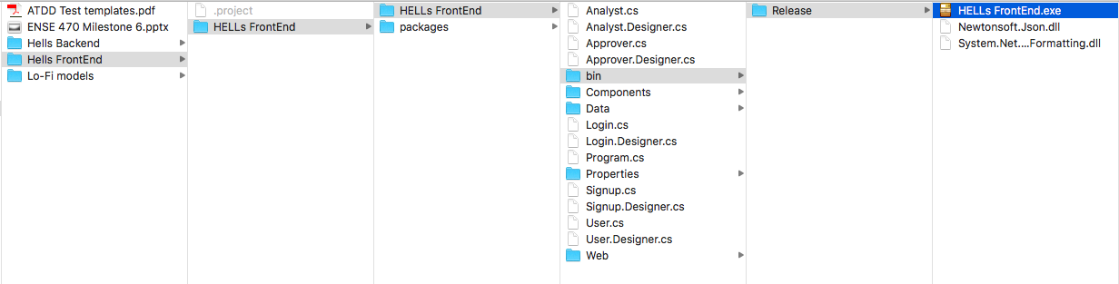
Comments
Even though it was easy to navigate through, navigating to the executable file needs some work on.
Documentation required for actually working on the project like what are the programs we need or how do can we make and see the changes in the project.

Slide 12
Refactor Review

Slide 13
ATDD test case Review

Slide 14
ATDD Review
The ATDD was relatively easy to find on github
Most of their ATDD test cases passed except for
Message related prompts
Analyst approvals
Some key ATDD tests missed
Missing escalation step from analyst to approver
Color coding in the final product

Slide 15
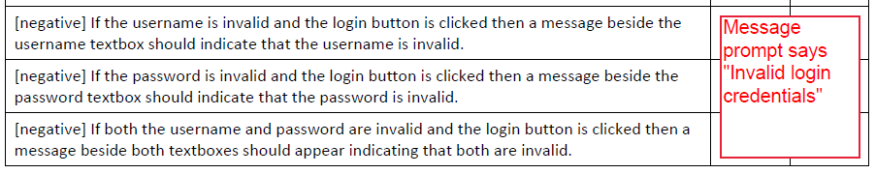

Message related issues

Slide 16
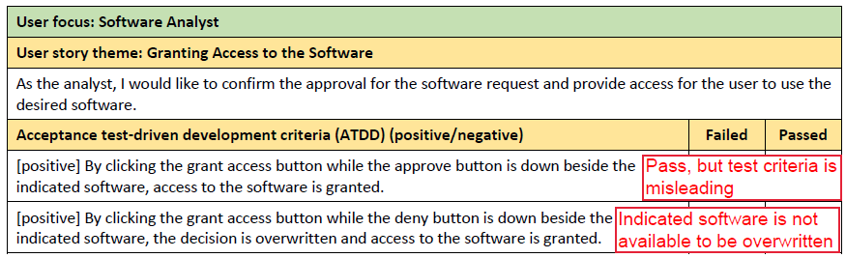
Analyst Approval
This is also applicable for analyst denying access

Slide 17
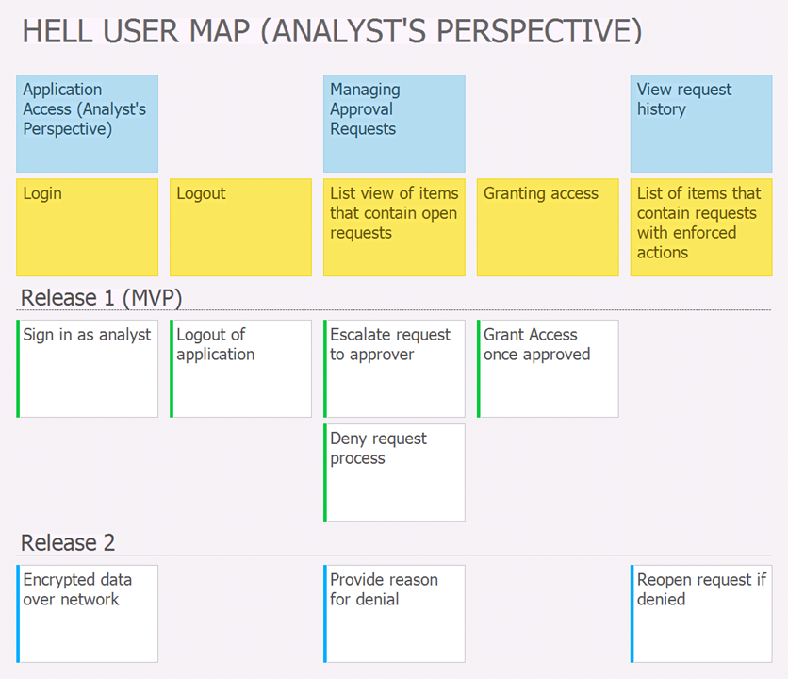
Missing ATDD test cases
Test cases relating to the escalation of request to approvers were not covered despite being apart of the process flow.

Slide 18
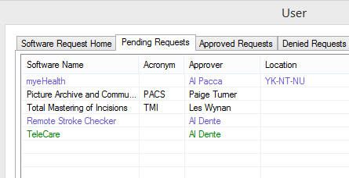
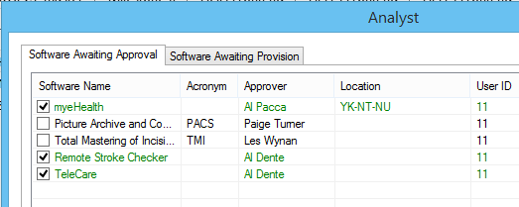
Missing ATDD test cases
Missing test cases relating to color codes seen by various types of users

Slide 19
Code Review

Slide 20
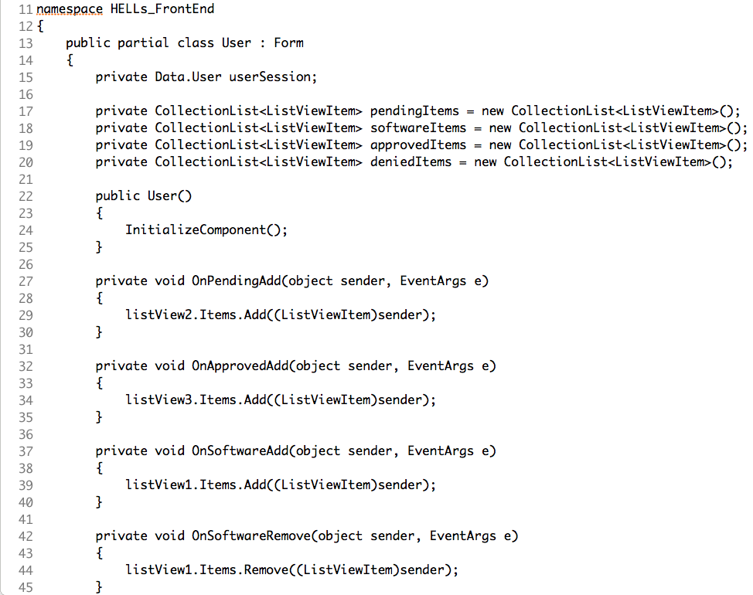
What is good?
Well organized code
Well defined classes
Even with basic knowledge of C# and PHP it is possible to understand what is happening
Functions and variables have meaningful name

Slide 21
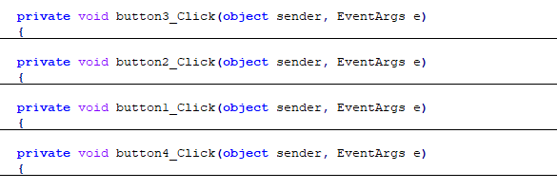
What could be better?
The name of the components is the default given by the framework.
Change for a name that is self explanatory.

Slide 22

What could be better?
Use POST method instead of GET method for passwords.
GET method is visible to everyone
POST method is invisible to others

Slide 23
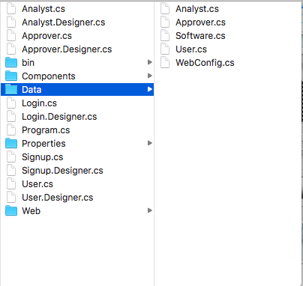
What could be better?
Do not use same name for different files
HELLs FrontEnd\Analyst.cs
HELLs FrontEnd\Data\Analyst.cs
There are some conventions for file/classes naming.
e.g. DAO for classes that access the database.

Slide 24
Design Pattern Discussion

Slide 25

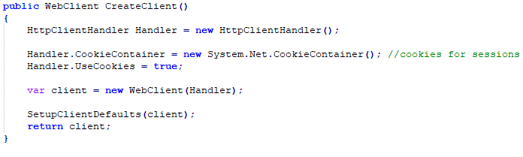
Factory Pattern
The usage of this pattern is to create an instance of a web client with different settings. They created the interface called HttpClientFactory and add different kind of users through the class HttpClientFactory.

Slide 26

Singleton Pattern
This pattern was used to solve the login session for this project. It’s used to prevent the creation of more than one instance of the same class.

Slide 27

Reflection Pattern
This method is used to change the type of session at run time through MSIL dynamic manipulation. It is a good way to access data at runtime.

Slide 28
Design Pattern Discussion
Three design patterns are applied in this project, which are the factory pattern, singleton pattern and reflection Pattern The application of these patterns are suitable and accurate.

Slide 29
Reviewed team’s response
Questions?

Slide 30
Group Reflection

Slide 31
How did you feel about this milestone? What did you like about it? What did you dislike?
It is a good way of getting the perspective from other groups to improve our project and vice-versa.
What did you learn about yourself as you collaborated and worked through this milestone?
We realized on how we could improve our own project as we were reviewing the other group’s project.
How will you use what you have learned going forward?
We could apply the review methods we used in this milestone when reviewing other projects in the future.
What “stuff & things” related to this milestone would you want help with?
It was difficult to refactor or review the code if not familiar.

